Slide 1
Word List: cede, ceed, cess
go; yield

Slide 2
to go or move back

Slide 3
recede
to go or move back

Slide 4
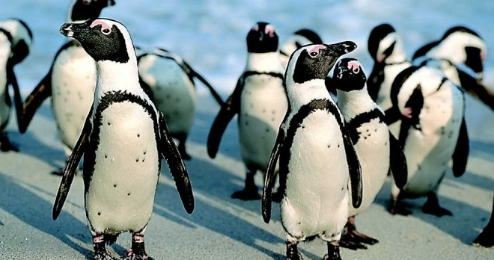
to keep on going; to go ahead with something; to move along

Slide 5
proceed
to keep on going; to go ahead with something; to move along

Slide 6
able to go in to, enter, or approach

Slide 7
accessible
able to go in to, enter, or approach

Slide 8
to yield to an opponent that one has lost; to give in; to admit that something is true and valid

Slide 9
concede
to yield to an opponent that one has lost; to give in; to admit that something is true and valid

Slide 10
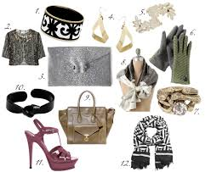
an article or item worn with an outfit that “goes with” or matches the outfit

Slide 11
accessory
an article or item worn with an outfit that “goes with” or matches the outfit

Slide 12
a person who goes after someone else (usually related to a person taking over a job that is of higher rank)

Slide 13
successor
a person who goes after someone else (usually related to a person taking over a job that is of higher rank)

Slide 14
to go before something else in time, order, place, or rank

Slide 15
precede
to go before something else in time, order, place, or rank

Slide 16
to go or be beyond the limit or expectations

Slide 17
exceed
to go or be beyond the limit or expectations

Slide 18
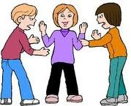
to mediate; to go between people to help them reach an agreement

Slide 19
intercede
to mediate; to go between people to help them reach an agreement

Slide 20
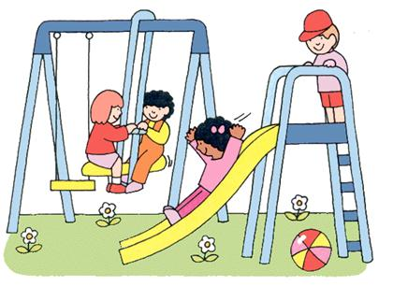
the time during which people go out to take a break

Slide 21
recess
the time during which people go out to take a break

